Slide 1
Varun Rishi
Question, Data, Hypothesis, Caveats
Final Project: SF-DAT-21

Slide 2
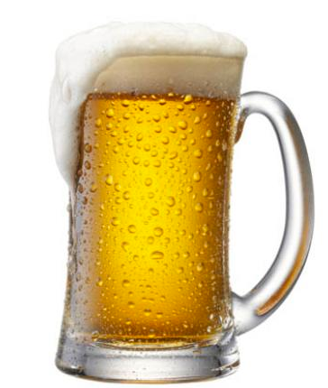

Beer = Happiness?

Slide 3
Does Beer Consumption by US State/ by country help predict overall happiness?
Data: National Institute on Alcohol Abuse- Consumption by state, five thirty-eight data on global Alcohol Consumption, World Happiness Report, Gallup Well Being Index
Hypothesis: Beer Consumption does not predict overall happiness either on the state or national level
Caveats: Look at three predictors- absolute Beer Consumption, Beer Consumption per Capita, & Beer consumption as % total Alcohol Consumption

Slide 4

How do we vote for the other guys?

Slide 5
Do opinions on presidential candidates help predict the balance of power in the US House of Representatives?
Data: Five thirty eight/Politico/Real Clear Politics National poll data from past 10 presidential elections, Congressional balance of power data
Hypothesis: National opinions and leanings on the presidential candidate/incumbent do not help predict the overall outcome of congressional elections
Caveats: For presidential election years, look at head to head candidate opinion polls in month preceding election. For mid-term years look at overall job approval rating for incumbent in month preceding election

Slide 6

What Kind of host will he be?

Slide 7
Can we predict whether an Airbnb host is using the platform to run a full time ‘hotel’ using web-scraped/public data on Airbnb Hosts and Listings?
Data: Inside Airbnb 2015-2016 Data on Listings availability, listings per host, number of reviews
Hypothesis: Listing availability, number of listings per host, and frequency of reviews cannot predict whether a host is using the platform to run a full time ‘hotel’
Caveats: Restrict Analysis to Urban Markets with high number of Airbnb listings (Perhaps using listings available divided by population as a measure. (Example New York, San Francisco, Paris etc.)

